Slide 1
Grade Pulse

Slide 2
Task Overview
Goal:
Students are to be recorded with their grades in the individual subjects.
1. editing the list of students 2. editing the list of subjects 3. editing the grades using a crosstab

Slide 3
Technologies Used
Frontend
Angular 17.3.12
BackEnd
C# .Net Core Rest API
Database
SQLite with Entity Framework
Source code Management Git

Slide 4
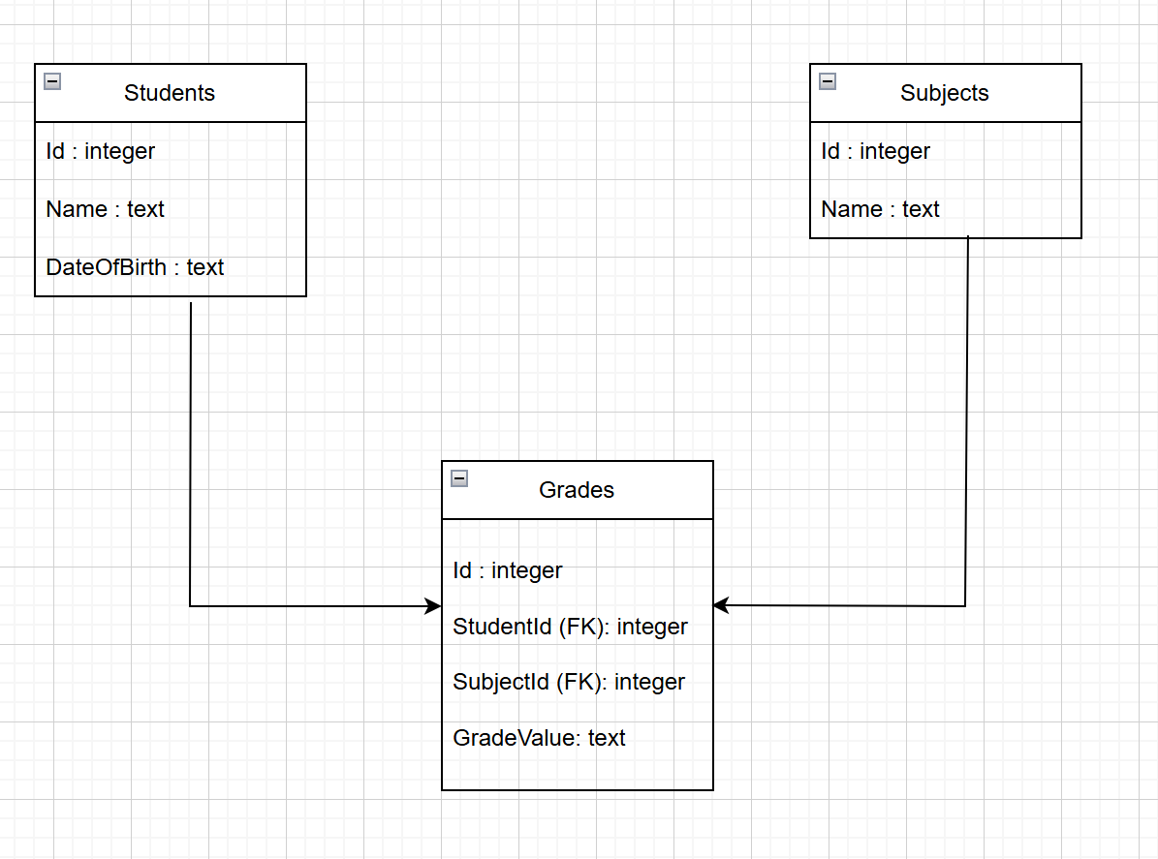
Table Design
Main Tables
Students: Details like ID, Name, and DOB
Subjects: Subject ID, Name Grades: Includes Student ID, Subject ID, and Grade Value

Slide 5
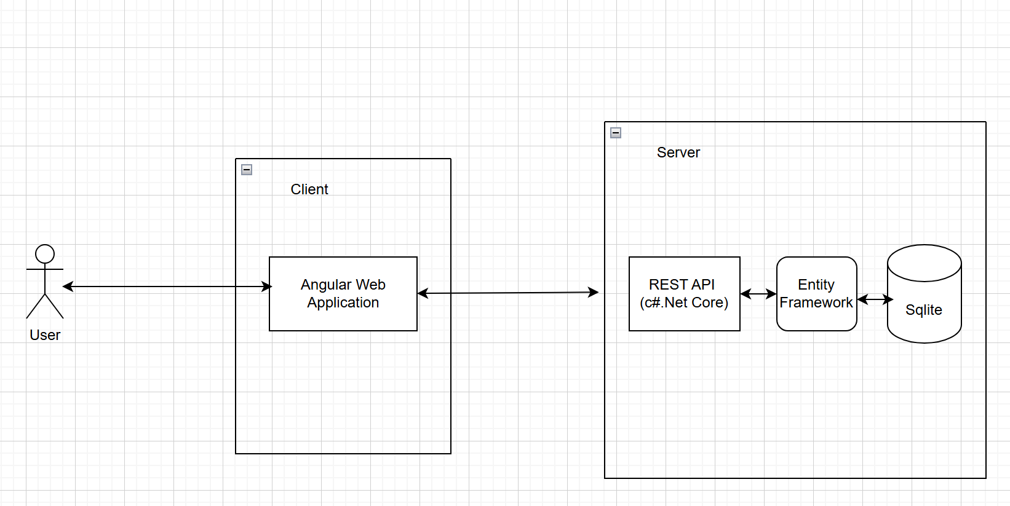
Architecture High Level

Slide 6
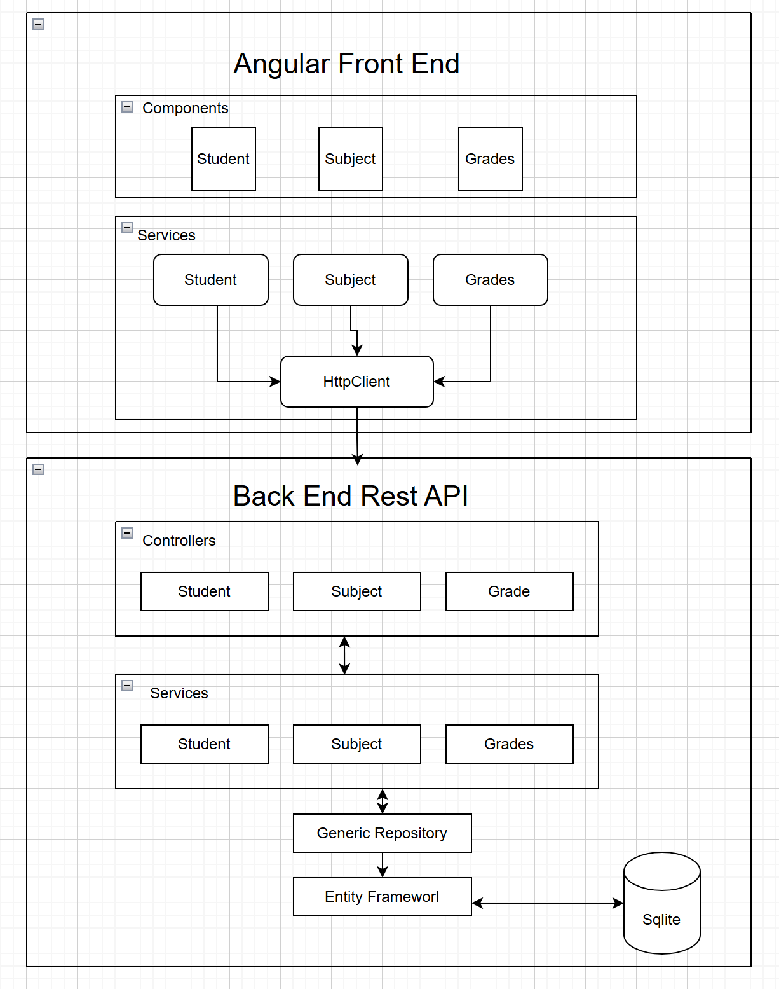
Moduels

Slide 7
Core Functionalities
Edit Students:
Edit Subjects:
Edit Gradings
Display Grades in a Crosstab:

Slide 8
Backend Implementation
REST API Endpoints:
CRUD operations for Students
CRUD operations for Subjects
CRUD operations for Grades
Display Crosstab data for Grades

Slide 9
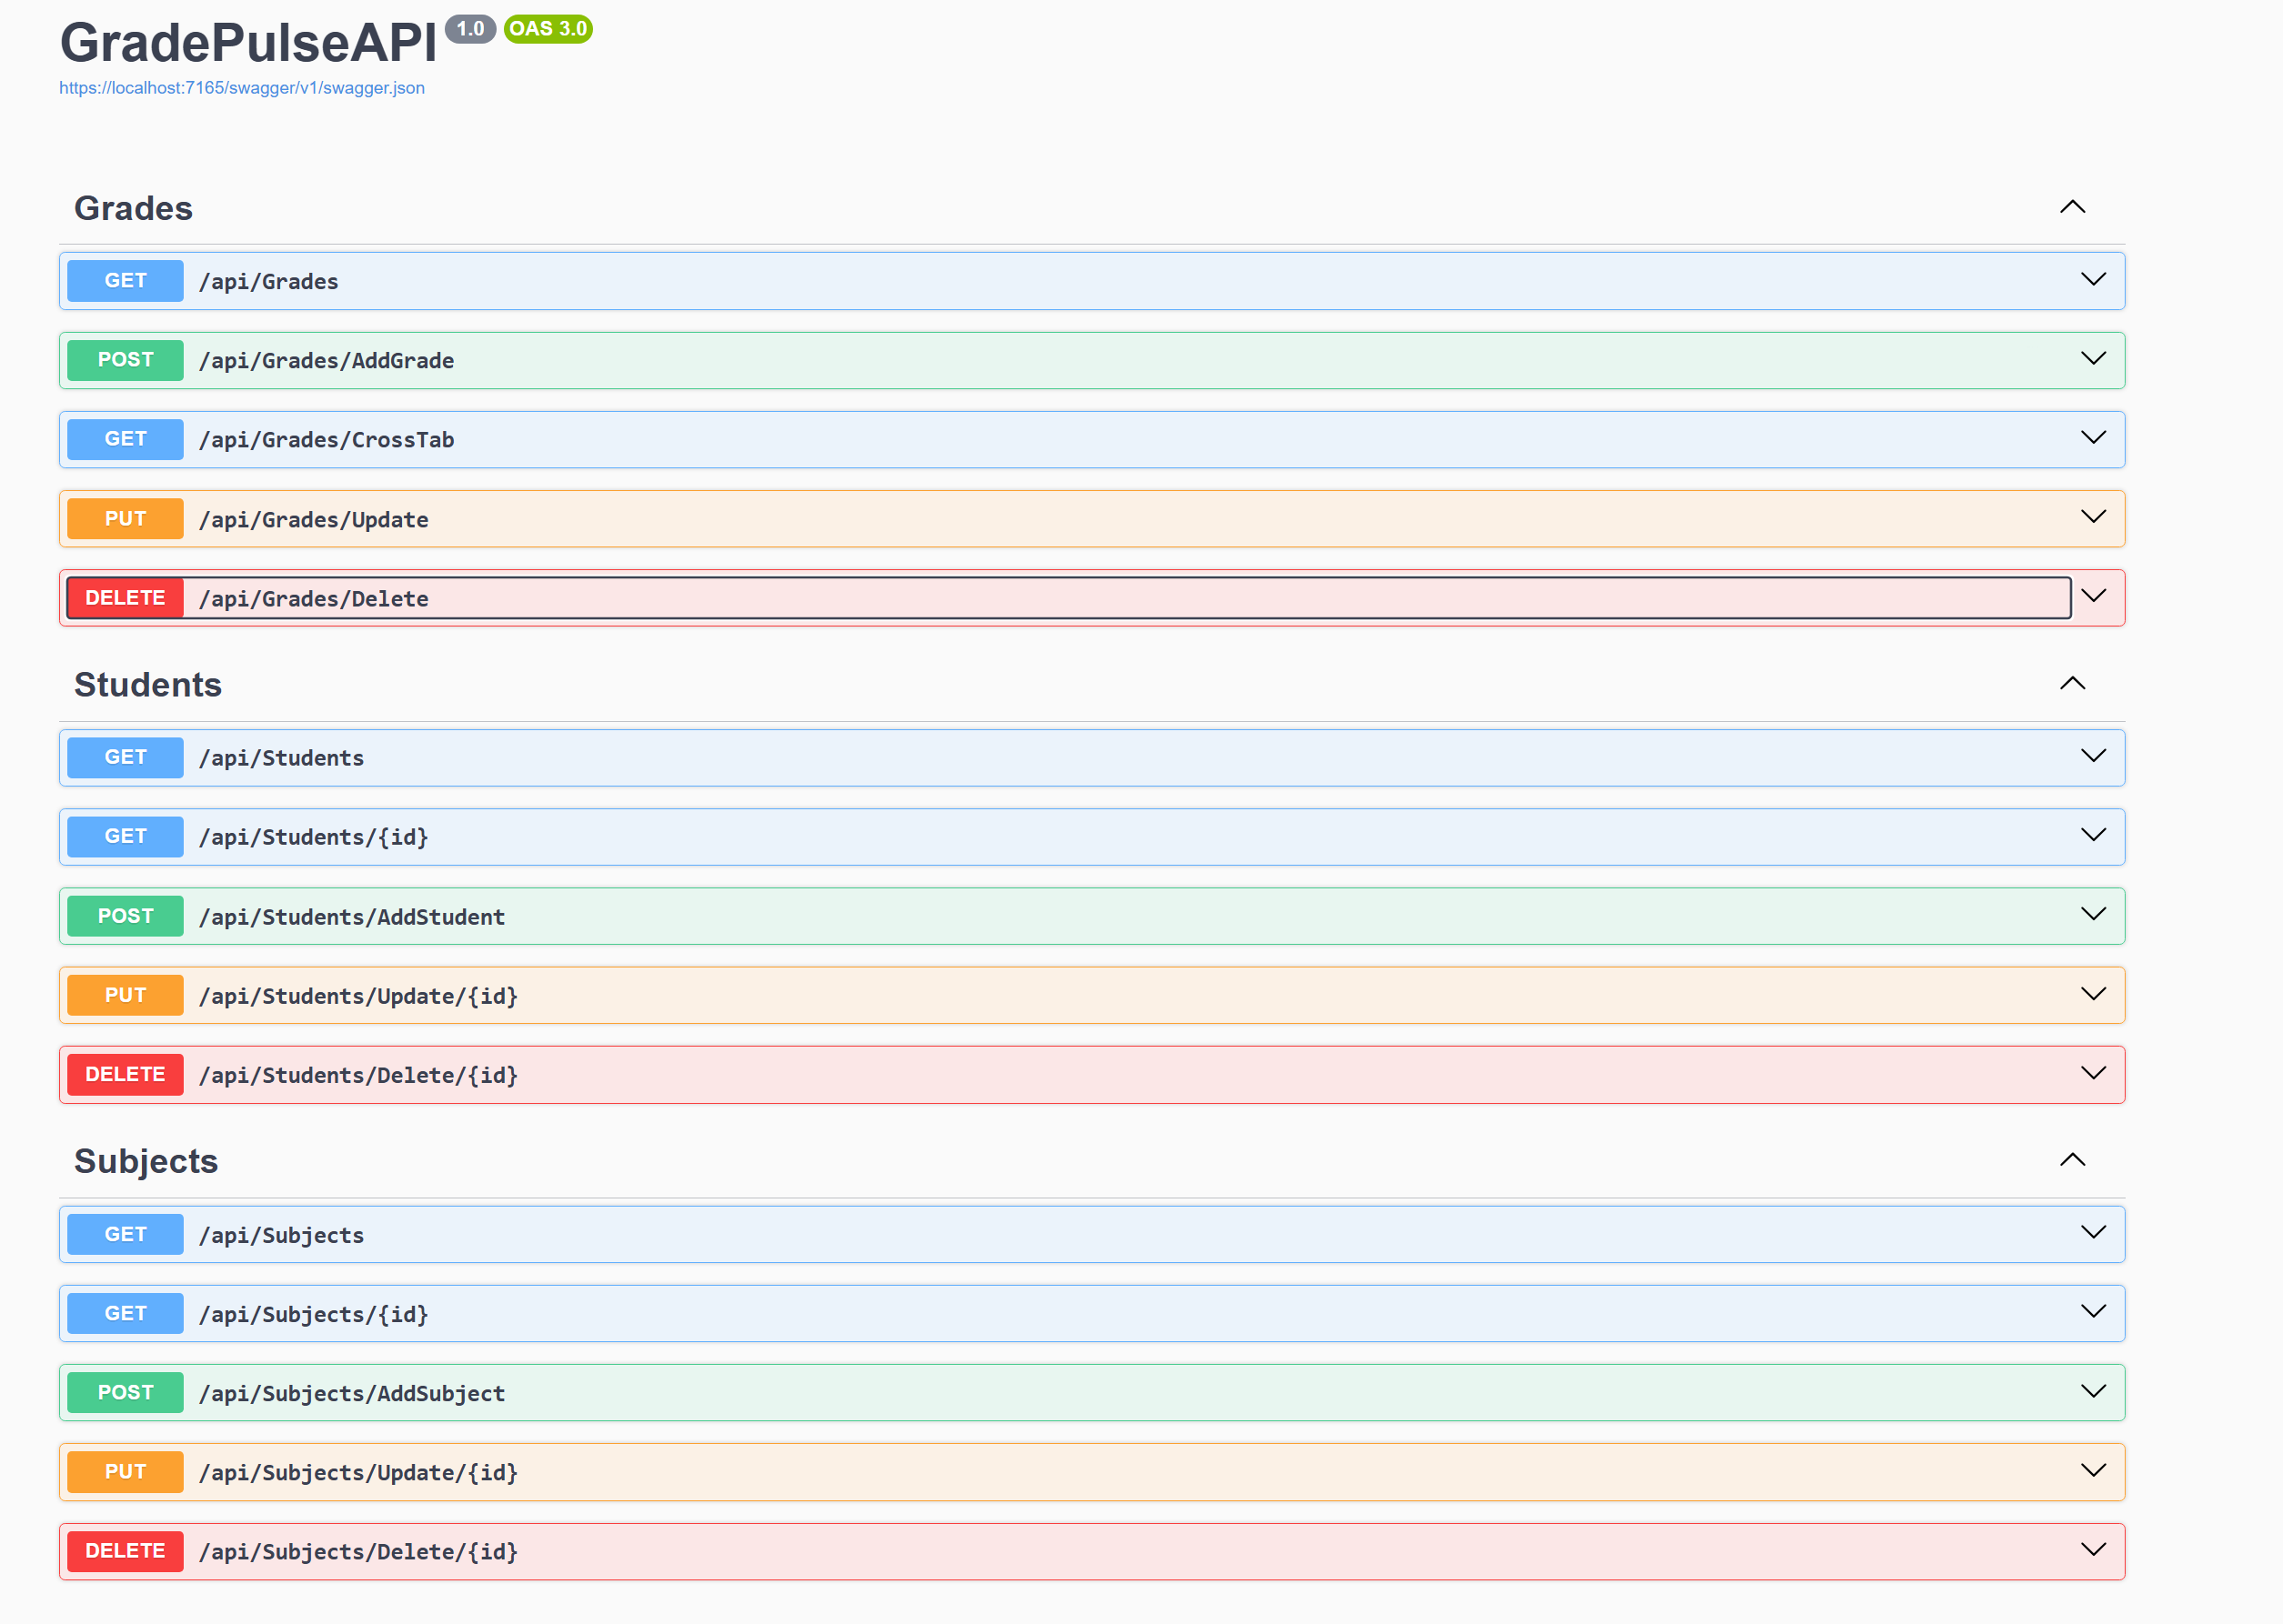
Backend Implementation
Swagger Documentation

Slide 10
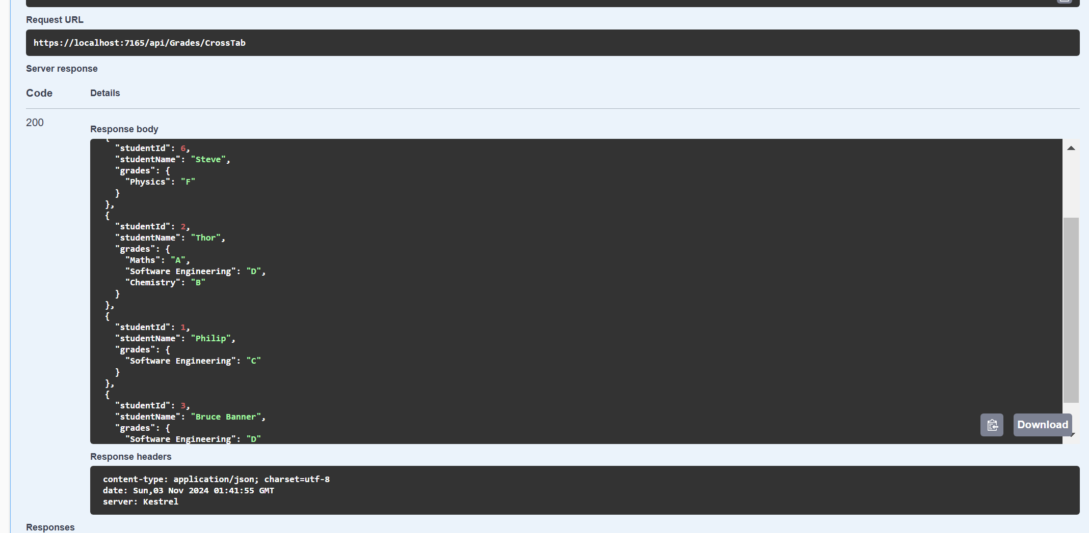
Backend Implementation
Crosstab Response Structure

Slide 11
Frontend Implementation
Angular Components.
Student Management
Subject Management
Grade Management
UI Elements
Bootstrap

Slide 12
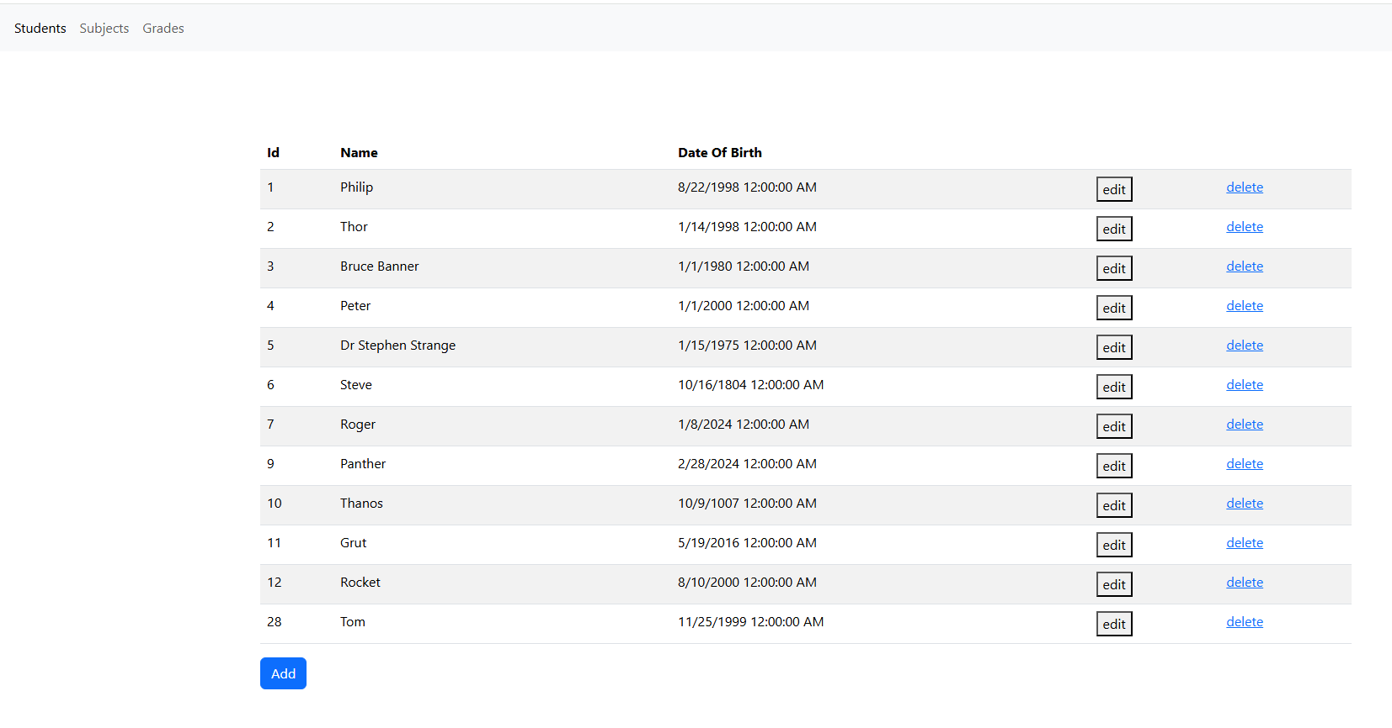
Frontend
Student Management

Slide 13
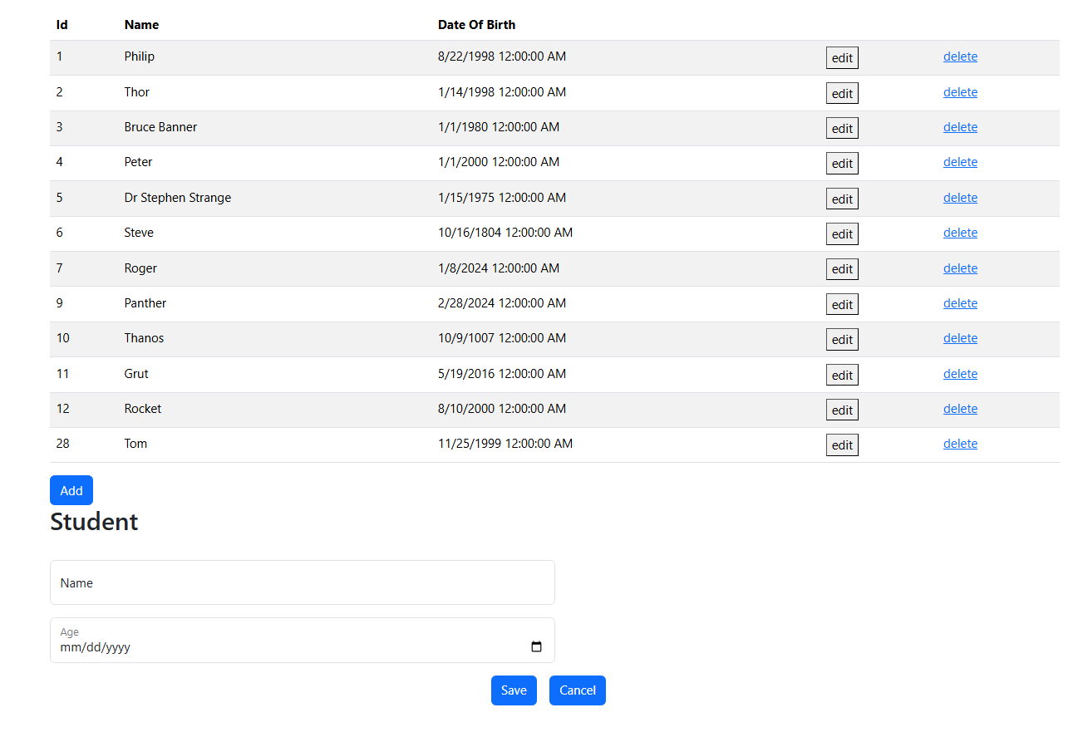
Frontend

Slide 14
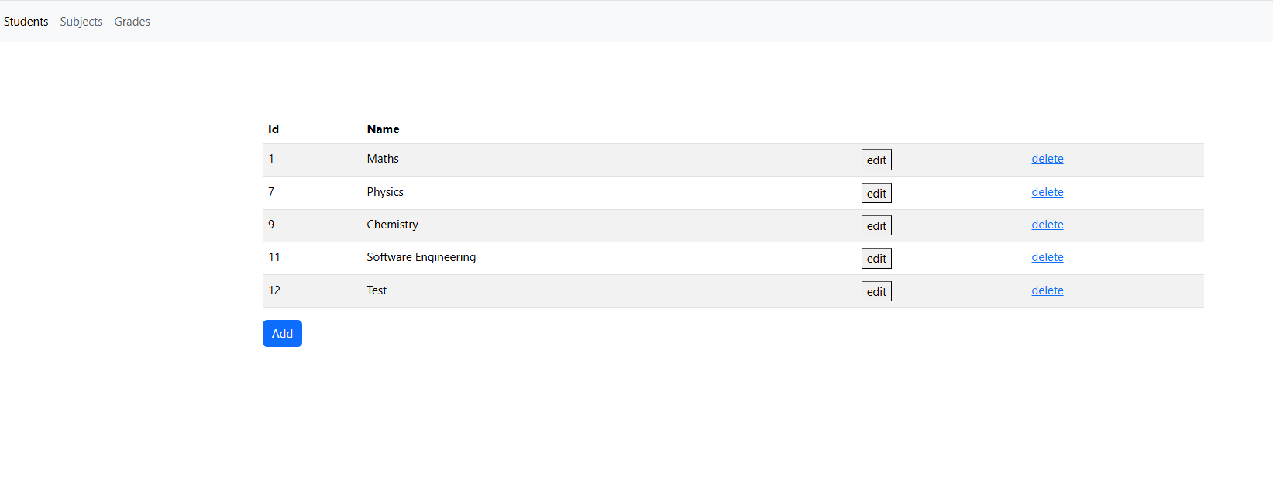
Frontend
Subject Management

Slide 15
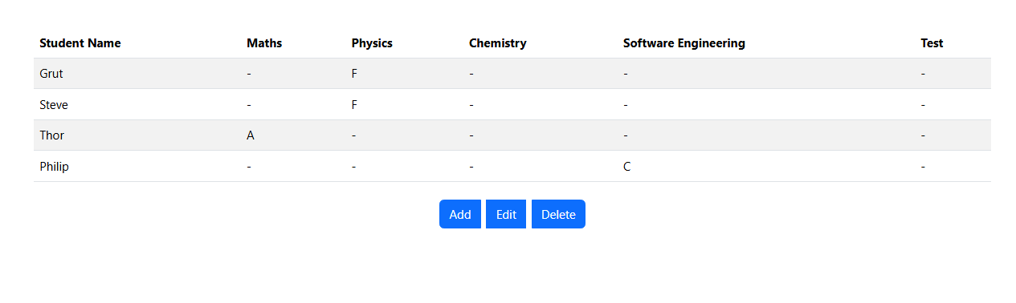
Frontend Implementation
Grade Management

Slide 16
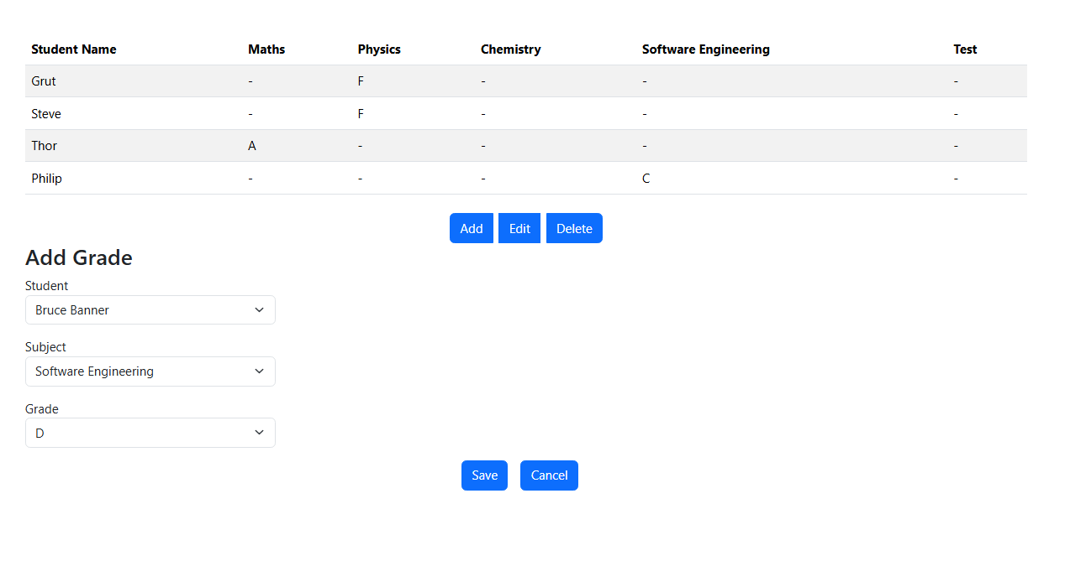
Frontend Implementation
Grade Management

Slide 17
DEMO

Slide 18
Thank you
Jubish Kammily

